Slide 1
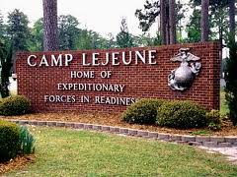
What happened at U.S. Marine Corps Base Camp Lejeune?
What did the National Research Council study find?
What health studies are being done on the exposed community?
March 10-13, 2014
C&P SME Training
Louisville, KY

Slide 2
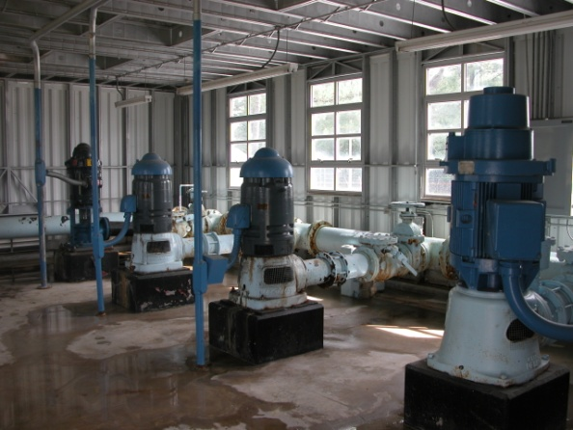
What happened at U.S. Marine Corps Base Camp Lejeune?
From the 1950s through the 1980s, people living or working at the U.S. Marine Corps Base Camp Lejeune, NC, were potentially exposed to drinking water contaminated with industrial solvents, benzene, and other chemicals

Slide 3
The primary chemicals were:
Perchloroethylene (PCE or “Perc”) (145 KB, PDF), a dry cleaning solvent
Trichloroethylene (TCE) (76 KB, PDF), a metal greasing solvent
Benzene (55 KB, PDF), a fuel component
Vinyl chloride (59 KB, PDF), which can form when TCE/PCE break down
http://www.atsdr.cdc.gov/sites/lejeune/chapterA_factsheet.html

Slide 4
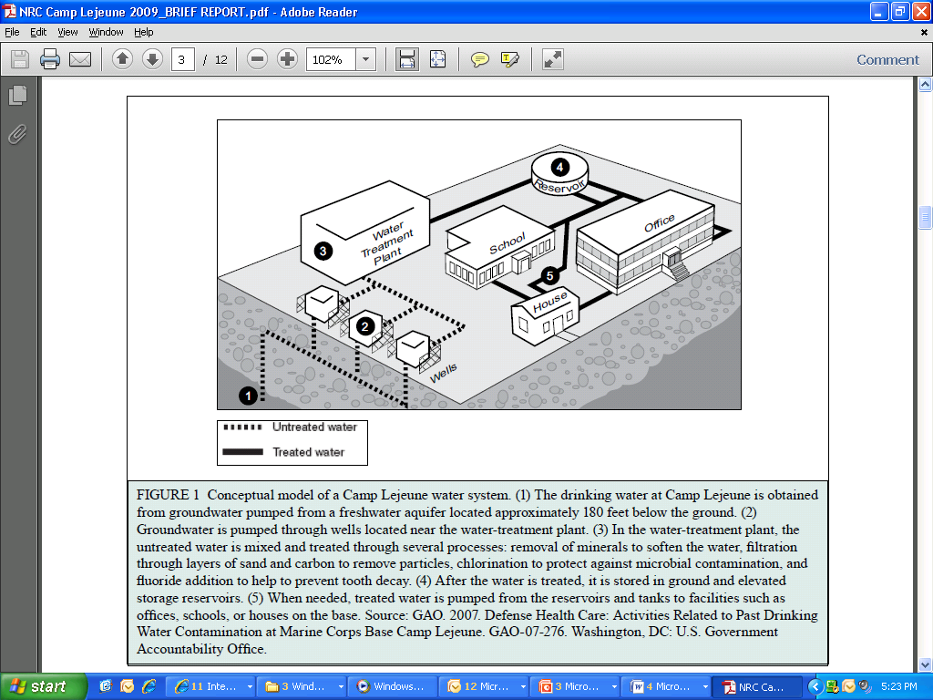
Schematic
Schematic of Water Supply:
Groundwater wells →Water Treatment Plant →Mixed & treated
→ Stored above/below ground → Pumped as needed to offices, schools, etc.

Slide 5
8 water treatment plants serving the base
Hadnot Point (HP)
Began operation in 1942
Areas served:
Main side barracks
Hospital Point family housing
Family housing at Midway Park, Paradise Point, and Berkeley Manor until June 1972
Tarawa Terrace (TT)
Began operation in 1952
Shut down in March 1987
Areas served:
Tarawa Terrace family housing
Knox trailer park
Holcomb Boulevard (HB)
Began operation in June 1972
Areas served:
Family housing at Midway Park, Paradise Point, Berkeley Manor, and Watkins Village
Tarawa Terrace family housing after March 1987
Courthouse Bay
Rifle Range
Onslow Beach
Montford Point/Camp Johnson
New River

Slide 6
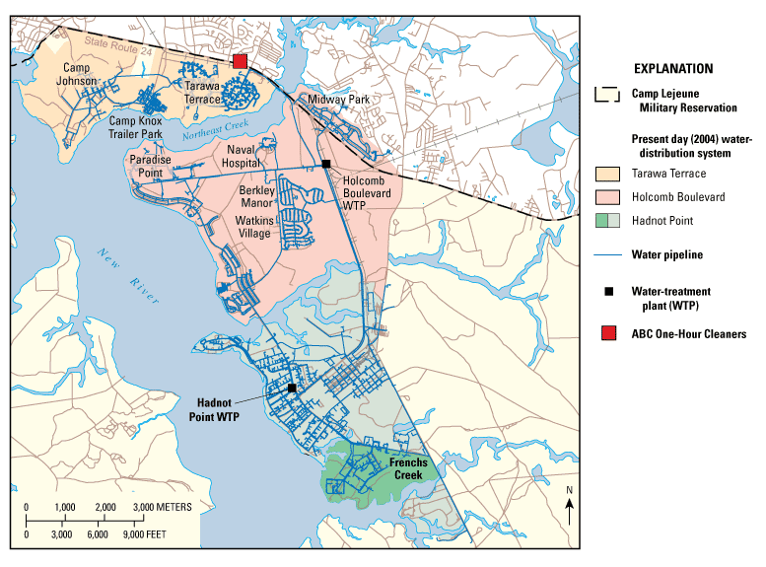
Location of exposed and unexposed groups
HB: Unexposed
June 1972-87(?)
TT: Exposed to PCE
1957-87
HP: Exposed to PCE, TCE, and BTEX
~1950 (?) – 87 (?)
X
TT: Tarawa Terrace
HB: Holcomb Blvd.
HP: Hadnot Point

Slide 7
How was the issue detected
VOCs detected in HP and TT wells during 1980-85 sampling program
Samples collected by Camp Lejeune staff
Chemicals detected included TCE, PCE, benzene, DCE
Contamination of wells began many years before detection
Other on-base treatment plants were not contaminated
Contamination of HP and TT drinking water systems was intermittent
Wells rotated in and out of service
Each system had more wells than necessary to supply water on any given day

Slide 8
Tarawa Terrace Treatment Plant
PCE (perchloroethylene or tetrachloroethylene) was the main contaminant
Maximum level detected in drinking water was 215 parts per billion (ppb) in February 1985
Source of contamination was ABC One-Hour Cleaners, an off-base dry cleaning firm
The most contaminated wells were shut down in February 1985
ATSDR used water modeling to estimate past exposure levels
PCE concentration exceeded the current EPA maximum contaminant level of 5 ppb in drinking water for 346 months during November 1957-February 1987

Slide 9
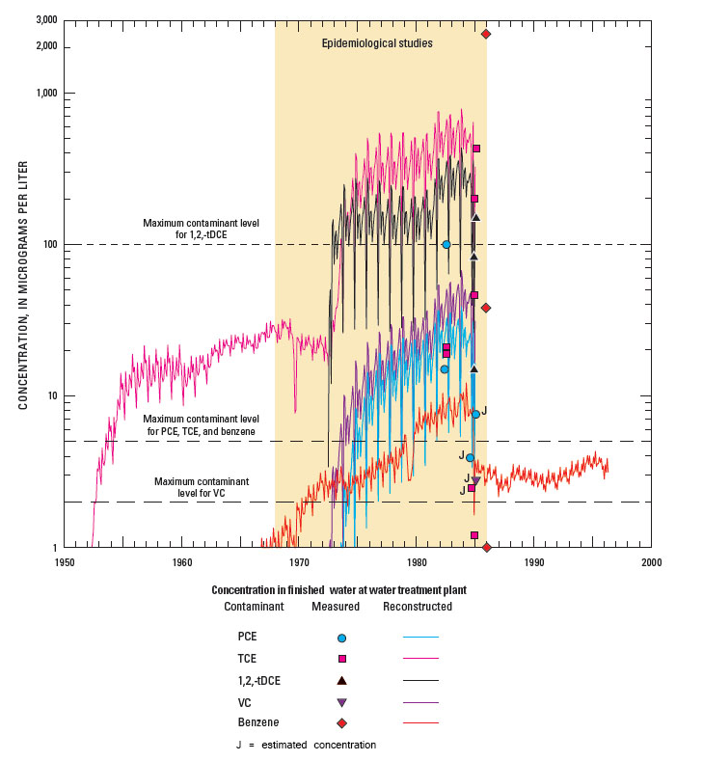
Hadnot Point Treatment Plant
TCE (trichloroethylene) was the main contaminant
Maximum level detected in drinking water was 1,400 ppb in May 1982
The current limit for TCE in drinking water is 5 ppb
Other contaminants detected included PCE, DCE, vinyl chloride and benzene
Multiple sources of contamination
Leaking underground storage tanks
Waste disposal sites
The most contaminated wells were shut down by February 1985
ATSDR used water modeling to estimate past exposure levels
At least one VOC exceeded its current EPA maximum contaminant level in drinking water during August 1953 and January 1985

Slide 10
Holcomb Boulevard (HB) wells were generally not contaminated
Contaminated water from the Hadnot Point (HP) water treatment plant supplied the HB drinking-water system when the HB plant was shut down during January 27-Febraury 7, 1985
Contaminated water from HP water treatment plant was used intermittently to supplement the HB drinking-water supply during dry spring and summer months when demand was high

Slide 11
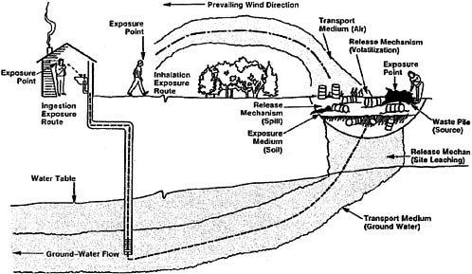
Environmental contamination from solvents and exposure pathways. Source: EPA 1989.

Slide 12
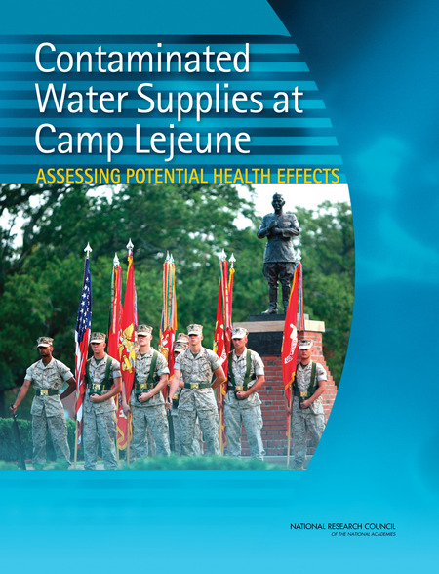
In 2009 the National Research Council (NRC) published a report: Contaminated Water Supplies at Camp Lejeune: Assessing Potential Health Effects
The report concludes that available scientific evidence does not provide sufficient basis to determine if the population of Camp Lejeune suffered adverse health effects as a result of exposure to contaminants in the water supply.

Slide 13
5 categories used by IOM to classify associations:
Sufficient Evidence of a Causal Relationship
Evidence from available studies is sufficient to conclude that a causal relationship exists between exposure to a specific agent and a specific health outcome in humans, and the evidence is supported by experimental data. The evidence fulfills the guidelines for sufficient evidence of an association (below) and satisfies several of the guidelines used to assess causality: strength of association, dose-response relationship, consistency of association, biologic plausibility, and a temporal relationship.
Sufficient Evidence of an Association
Evidence from available studies is sufficient to conclude that there is a positive association. A consistent positive association has been observed between exposure to a specific agent and a specific health outcome in human studies in which chance and bias, including confounding, could be ruled out with reasonable confidence. For example, several high-quality studies report consistent positive associations, and the studies are sufficiently free of bias, including adequate control for confounding.
Limited/Suggestive Evidence of an Association
Evidence from available studies suggests an association between exposure to a specific agent and a specific health outcome in human studies, but the body of evidence is limited by the inability to rule out chance and bias, including confounding, with confidence. For example, at least one high-quality study reports a positive association that is sufficiently free of bias, including adequate control for confounding. Other corroborating studies provide support for the association, but they were not sufficiently free of bias, including confounding. Alternatively, several studies of less quality show consistent positive associations, and the results are probably not due to bias, including confounding.
Inadequate/Insufficient Evidence to Determine Whether an Association Exists
Evidence from available studies is of insufficient quantity, quality, or consistency to permit a conclusion regarding the existence of an association between exposure to a specific agent and a specific health outcome in humans.
Limited/Suggestive Evidence of No Association
Evidence from well-conducted studies is consistent in not showing a positive association between exposure to a specific agent and a specific health outcome after exposure of any magnitude. A conclusion of no association is inevitably limited to the conditions, magnitudes of exposure, and length of observation in the available studies. The possibility of a very small increase in risk after exposure studied cannot be excluded.

Slide 14
Study Findings
Sufficient Evidence of a Causal Relationship
No outcomes
Sufficient Evidence of an Association
No outcomes
Limited/Suggestive evidence of no association
No outcomes

Slide 15
The NRC review found 14 conditions with limited/suggestive evidence
Esophageal cancer (PCE)
Lung cancer (PCE)
Breast cancer (PCE)
Bladder cancer (PCE)
Kidney cancer
Adult leukemia (solvent mixtures)
Multiple myeloma (solvent mixtures)
Myleodysplasic syndromes (solvent mixtures)
Renal toxicity (solvent mixtures)
Hepatic steatosis (solvent mixtures)
Female infertility (with concurrent exposure to solvent mixtures)
Miscarriage (with exposure to PCE during pregnancy)
Scleroderma (solvent mixtures)
Neurobehavioral effects (solvent mixtures)

Slide 16
Inadequate/Insufficient Evidence to Determine Whether an Association Exists
Oral/pharyngeal cancer
Nasal cancer
Laryngeal cancer
Esophageal cancer (TCE)
Stomach cancer
Colon cancer
Rectal cancer
Pancreatic cancer
Hepatobiliary cancer
Lung cancer (TCE)
Bone cancer
Soft tissue sarcoma
Melanoma
Non-melanoma skin cancer
Breast cancer (TCE)
Cervical cancer
Ovarian/uterine cancer
Prostate cancer
Bladder cancer (TCE
Cancer of the brain or central nervous system
Non-Hodgkin lymphoma
Hodgkin disease
Multiple myeloma
Adult leukemia
Myelodysplasic syndromes
Childhood leukemia
Childhood neuroblastoma
Childhood brain cancer
Aplastic anemia
Congenital malformations
Male infertility
Female infertility (after exposure cessation)
Miscarriage, preterm birth, or fetal growth restriction (from maternal preconception exposure or paternal exposure)
Preterm birth or fetal growth restriction (from exposure during pregnancy)
Cardiovascular effects
Liver function or risk of cirrhosis
Gastrointestinal effects
Renal toxicity
Amyotrophic lateral sclerosis
Parkinson disease
Multiple sclerosis
Alzheimer disease
Long-term reduction in color discrimination
Long-term hearing loss
Long-term reduction in olfactory function

Slide 17
Outreach to people potentially exposed

Slide 18
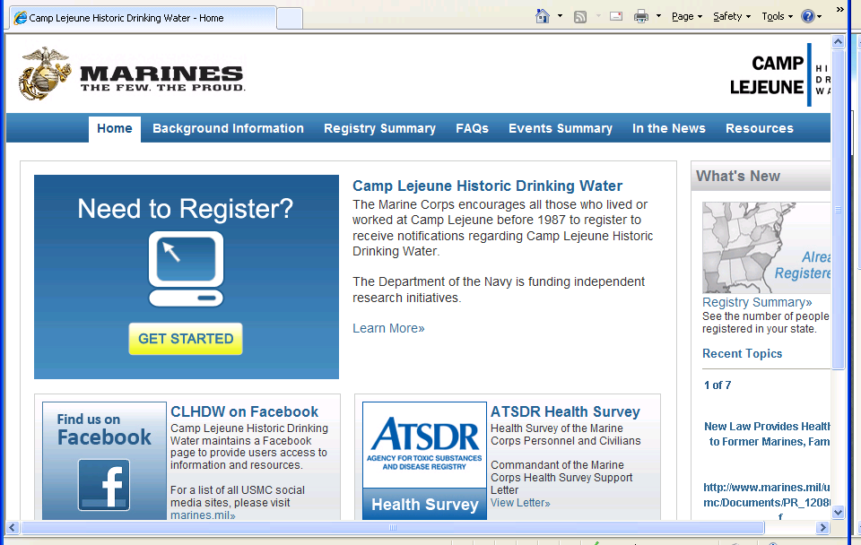
USMC - Information Self-Registry

Slide 19
USMC - Q and A Booklet
https://clnr.hqi.usmc.mil/clwater/documents/CLHDW_Booklet.pdf

Slide 20
USMC timeline (booklet pp. 18-19):

Slide 21
The Few, The Proud, The Forgotten Website for Veterans, Family, etc.
Documentary:
http://semperfialwaysfaithful.com/

Slide 22
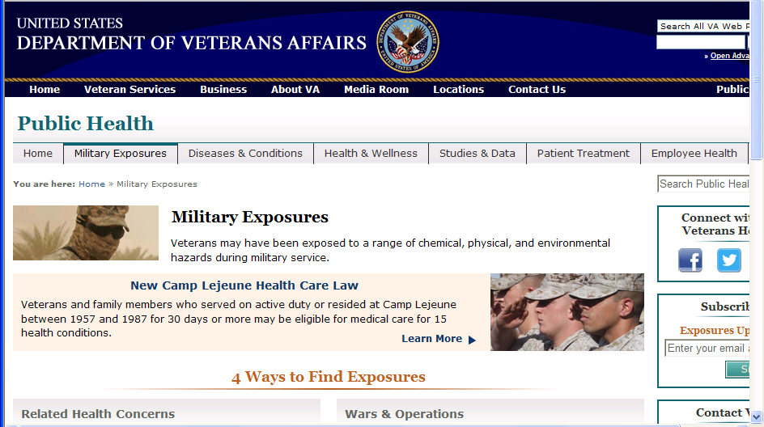
VA - OPH Website

Slide 23
ATSDR – Website http://www.atsdr.cdc.gov/sites/lejeune/index.html, Community Assistance Panel (“CAP”), and research studies
CAP established by ATSDR in 2006
Community members provide input to ATSDR on proposed studies, etc.
Meet quarterly in Atlanta (the public can call in)

Slide 24
ATSDR water modeling : Reconstructing historical drinking-water concentrations
What chemical compounds contaminated drinking water at Camp Lejeune and where did they come from (sources)?
When did contaminated groundwater reach water-supply wells and what was the duration of the contamination?
How was contaminated water distributed through water-distribution systems?
What were the frequency, duration, and spatial distribution of exposure to contaminated drinking water (monthly drinking-water concentrations)?
What are the ranges of concentration values (based on modeling results) for a specific month?

