Slide 1
Honoring America's Veterans and Caring for Camp Lejeune Families Act of 2012
March 2015
C&P SME Training
Louisville, KY

Slide 2
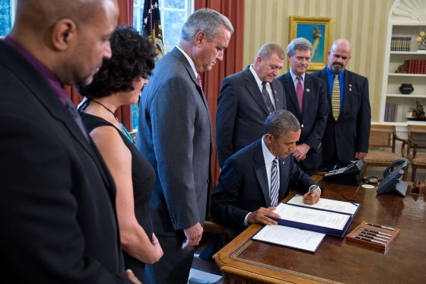
President Obama Signs the “Honoring America's Veterans and Caring for Camp Lejeune Families Act of 2012”
Among those standing with the President at the Aug 6 signing were Jerry Ensminger, a Marine Corps
veteran who has been an advocate for affected families, and Mike Partain, who was born at Camp
Lejuene and later developed male breast cancer. The bill the President signed was named after Janey
Ensminger, the Master Sargeant's daughter who passed away from leukemia at age nine.

Slide 3
SEC. 102. of the “Honoring America’s Veterans and Caring for Camp Lejeune Families Act of 2012”
Provides hospital care and medical services to Veterans and Family Members who were stationed or resided at CL for > 30 days between Aug. 1,1953 to Dec. 31, 1987:
Veterans on active-duty status assigned to Camp Lejeune
Family Members who were residents on Camp Lejeune or in-utero
VA shall provide hospital care and medical services for 15 covered conditions notwithstanding that there is insufficient medical evidence to conclude that such illnesses or conditions are attributable to such service.
Cannot provide care for conditions found to have another cause
VA is the last payer for family member care (out-of-pocket expenses after other health plan pays.)

Slide 4
Family Members
They will be able to continue to receive health care from own providers. VA will not be providing direct health care to non-Veterans.
“Don't cancel your health insurance. This program only covers the 15 health conditions listed above. It doesn't meet the minimum standard for health coverage under the Affordable Care Act. “

Slide 5
Health Care vs. Compensation
Compensation benefits
“The Aug. 6, 2012 law applies to health care, not disability compensation. At this time, there is insufficient scientific and clinical evidence to establish a presumptive association between service at Camp Lejeune during the period of water contamination and the development of certain diseases.
Veterans may file a claim for disability compensation for health problems they believe are related to exposure to contaminated water at Camp Lejeune. VA decides these claims on a case-by-case basis. “

Slide 6
The 15 Conditions in the Health Care Law
‘(i) Esophageal cancer.
‘(ii) Lung cancer.
‘(iii) Breast cancer.
‘(iv) Bladder cancer.
‘(v) Kidney cancer.
‘(vi) Leukemia.
‘(vii) Multiple myeloma.
‘(viii) Myleodysplastic syndromes.
‘(ix) Renal toxicity.
‘(x) Hepatic steatosis.
‘(xi) Female infertility.
‘(xii) Miscarriage.
‘(xiii) Scleroderma.
‘(xiv) Neurobehavioral effects.
‘(xv) Non-Hodgkin’s lymphoma.

Slide 7
Clinical Eligibility
Difference in decision making in Veteran care vs family member care
Clinical input is required for three decision points:
Does the applicant have a medical illness or condition specified in the law?
Is there another cause for the medical illness or condition?
Which treatments are associated with the medical illness or condition?
The Clinical Guidance document and an algorithm has been developed to provide assistance to clinicians in answering these decision points.

Slide 8
Clinical Decision Process
To determine if a patient has a condition covered by the law:
Establish whether the patient’s illness meets diagnostic criteria for one of the covered conditions
Establish whether the time of onset is consistent an exposure at Camp Lejeune
Some of the 15 conditions have clear evidence-based clinicopathologic diagnostic criteria (cancers) while others are less clearly defined or supported by existing medical scientific knowledge (renal toxicity, neurobehavioral effects.)
Some well defined but have an onset concurrent with exposure and are unlikely to occur years after exposure to contaminated water (miscarriage, infertility, hepatic steatosis, renal toxicity, neurobehavioral effects.)

Slide 9
Onset affects Determination
Covered Conditions:
Hepatic Steatosis
Reproductive Effects: Miscarriage and Infertility in Women
Neurobehavioral Effects
Renal toxicity
These conditions are identified in the scientific literature to occur as a result of acute exposure to solvents. The conditions occur during acute exposure or shortly thereafter and unlikely months or years after CL.
Hepatic steatosis and neurobehavioral effects generally resolve after cessation of exposure.
Reproductive Effects have been identified to occur at the time of exposure.
If clinician concludes timing of onset of condition is not consistent with exposure to CLCW VA cannot waive copays or reimburse family members.

Slide 10
Poorly Defined Diagnostic Criteria
Conditions: Renal toxicity & Neurobehavioral Effects
Not discrete diagnostic entities with commonly recognized criteria or clinicopathological findings.
Clinical judgment guided by:
Medical history & diagnostic findings
Manifestations began during or shortly after residence at CL
Identification of a cause other than exposure to CLCW
If reasonable doubt as to diagnosis or primary cause, resolve in favor of the Veteran or family member.
IOM is reviewing the definition of these terms (report due 2nd quarter FY 2015)

Slide 11
Camp Lejeune Implementation Steering Committee
Developing policy for administrative eligibility,
clinical eligibility, and delivery of care
Veterans
Family Members
Developing risk communication materials
Veterans
Family Members
VA providers & other staff
Tracking health care inquiries and delivery
~80% of Veterans who inquired to date were already enrolled
~4:1 ratio of Veteran: Family Member inquiries
Social Workers will assist Family Members with finding sources of care until it becomes available through VA (Congressional funding + Regs)

Slide 12
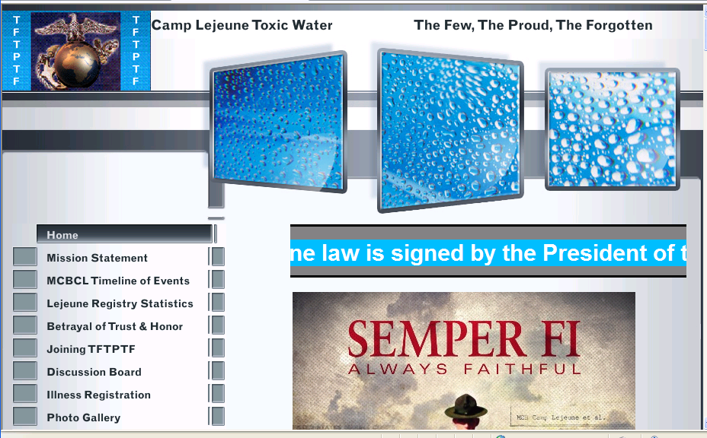
http://www.tftptf.com/

